Slide 1
Machine Learning Based Raman Spectra Classification for API Polymorphs
Ziyi Cao, Minghe Li

Slide 2
Content
College/Dept. Arial Regular 12 point

Slide 3
Background
Subhead Impact Regular 24 Point Ever True Blue
Bulleted copy. Arial Regular 18 point minimum. Keep it short with bite-size chunks of information.
Bulleted copy. Arial Regular 18 point minimum. Keep it short with bite-size chunks of information.
Bulleted copy. Arial Regular 18 point minimum. Keep it short with bite-size chunks of information.
Bulleted copy. Arial Regular 18 point minimum. Keep it short with bite-size chunks of information.
College/Dept. Arial Regular 12 point

Slide 4
Spectra Aquisition
Subhead Impact Regular 24 Point Ever True Blue
Bulleted copy. Arial Regular 18 point minimum. Keep it short with bite-size chunks of information.
Bulleted copy. Arial Regular 18 point minimum. Keep it short with bite-size chunks of information.
Bulleted copy. Arial Regular 18 point minimum. Keep it short with bite-size chunks of information.
Bulleted copy. Arial Regular 18 point minimum. Keep it short with bite-size chunks of information.
College/Dept. Arial Regular 12 point

Slide 5
Workflow
How we find best method and parameters for our data set:
01
Multiclass
Boosting
Performance
AdaBoost DecisionTreeClassifier
Suitable algorithm for our 3 classes dataset.
Converts weak learner to strong learners
Reach best accuracy using about 5 iterations.
02
AdaBoost SVMClassifier
Linear Kernel
Performance
Simplest kernel function
Reach 100% at iteration 2.
03
SVM
Performance
No Overfitting
Multiclass SVM
Fits our dataset
Setting Penalty parameter C as 50 will get 100% accuracy
As we increase Penalty parameter, validation accuracy is still 100%

Slide 6
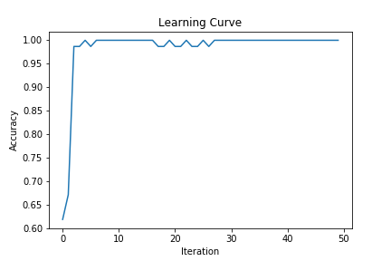
Adaboost-DecisionTreeClassifier
Parameters
n_estimators: The maximum number of estimators at which boosting is terminated
Learning_rate: Learning rate shrinks the contribution of each classifier.
Algorithm: The SAMME.R real boosting algorithm or SAMME discrete boosting algorithm
Adaboost is robust to overfitting.

Slide 7
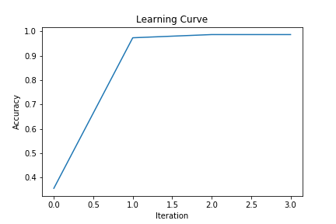
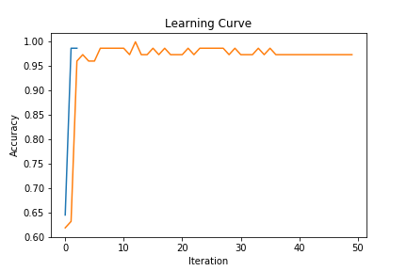
Adaboost-SVMClassifier
Impressive Performance
The adaboost SVM classifier always terminates at second or third iteration because the accuracy reached 100%.
The comparison between decisiontree and SVM as weaker learners.
Blue line: the accuracy of the Decisiontree.
Orange line: the accuracy of the SVM.

Slide 8
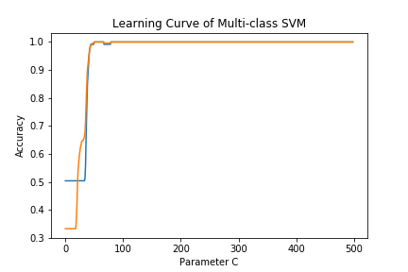
Multi-class SVM
One vs. ALL
Idea:
The algorithm will first determine whether the data belong to class 3 or not.
If not, whether the data belong to class 2 or not.
If not, the data belong to class 1.
Performance:
When Penalty parameter C is larger than 100, the accuracy will reach 100%
Blue line: the accuracy of the test data.
Orange line: the accuracy of the validation data

Slide 9
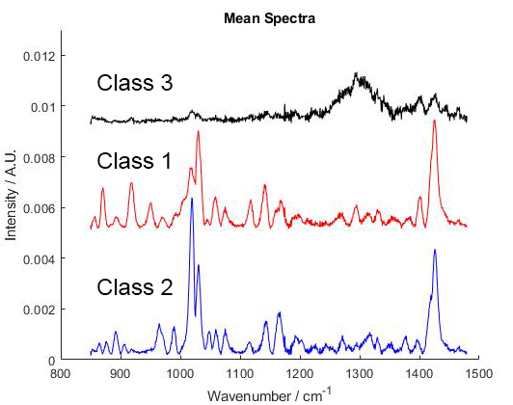
Multi-Class SVM
Hypothesis of no overfitting
In our point of view, the reason of no overfitting is that Raman spectra provides detailed information about chemicals. In another word, if the SNR is high enough, Raman spectra intrinsically can be well separated.

Slide 10
Conclusion
Machine Learning is a powerful tool to analyze chemical data, especially information abundant dataset, like Raman spectra (1340 dimensions) .
Raman spectra information is directly related to its chemical structure, phase and polymorphy, crystallinity and molecular interactions. Because the peaks of different functional group in Raman spectra are intrinsically well separated which result in high accuracy and no overfitting.

Slide 11
Thank You
A conclusion, thank-you message or contact information could go here. Arial Regular 18 point minimum.

